Slide 1


E-Mall: Revolutionizing Online Shopping
Built with MERN Stack for seamless online retail solutions

Slide 2

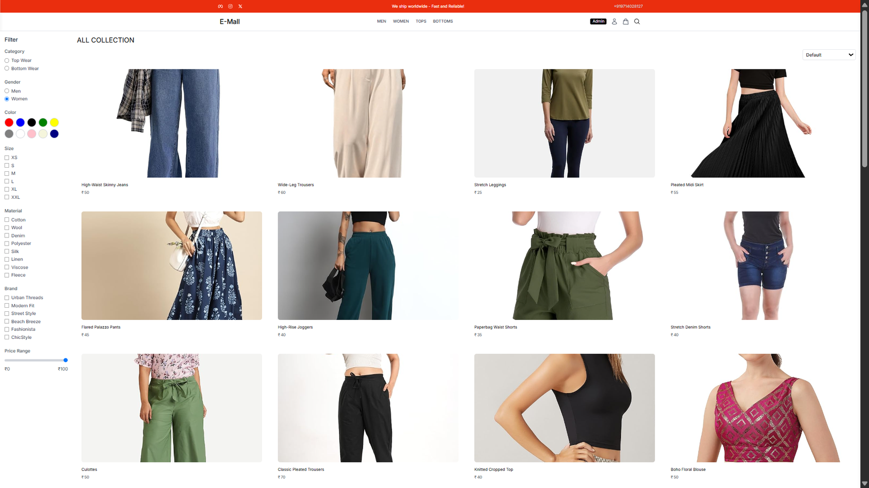
E-Mall Agenda
Key Topics for E-Mall Presentation
Innovative features of the E-Mall project
Technologies used in the MERN stack
Guidelines for effective usage
Contact information for further queries

Slide 3
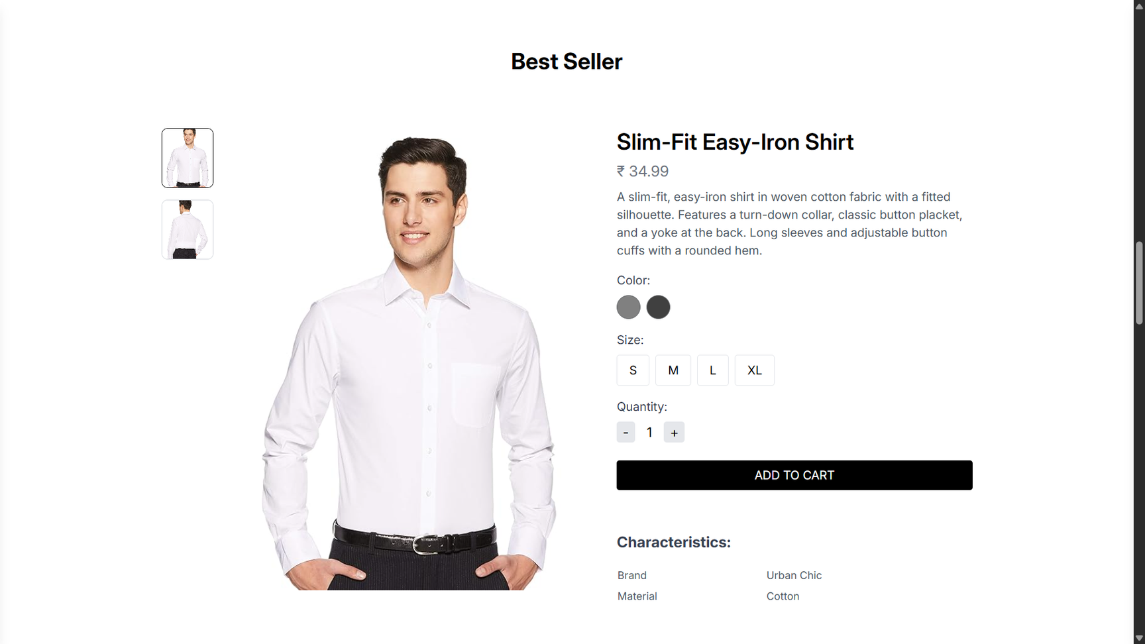

E-Mall: Key Features of Our Platform
Innovative solutions for seamless online shopping
E-Mall offers secure authentication, an extensive product catalog, a user-friendly shopping cart, and a comprehensive admin dashboard, ensuring an efficient shopping experience for everyone.

Slide 4
MERN Stack Architecture
Utilizing the MERN stack ensures a robust, scalable application with seamless data management.
Innovative Solutions in E-Mall
Performance Optimization Techniques
Implementing caching and lazy loading enhances performance, ensuring a smooth user experience.
Exploring the Technical Aspects of E-Mall
User Experience Design
Focus on intuitive navigation and responsive design greatly improves overall user satisfaction.

Slide 5
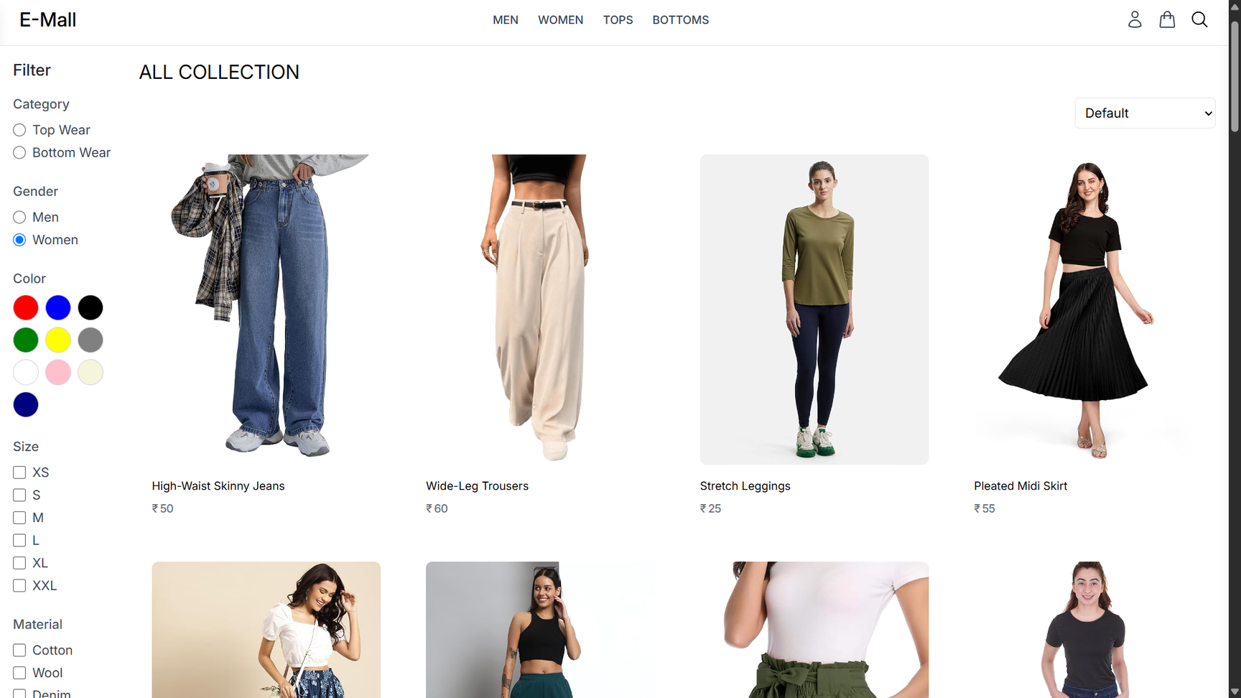
Technologies Behind the E-Mall Project
Exploring the power of the MERN Stack
The MERN stack combines MongoDB, Express.js, React.js, and Node.js to provide a powerful framework for building modern web applications. This technology enables seamless data handling and user interactions.

Slide 6
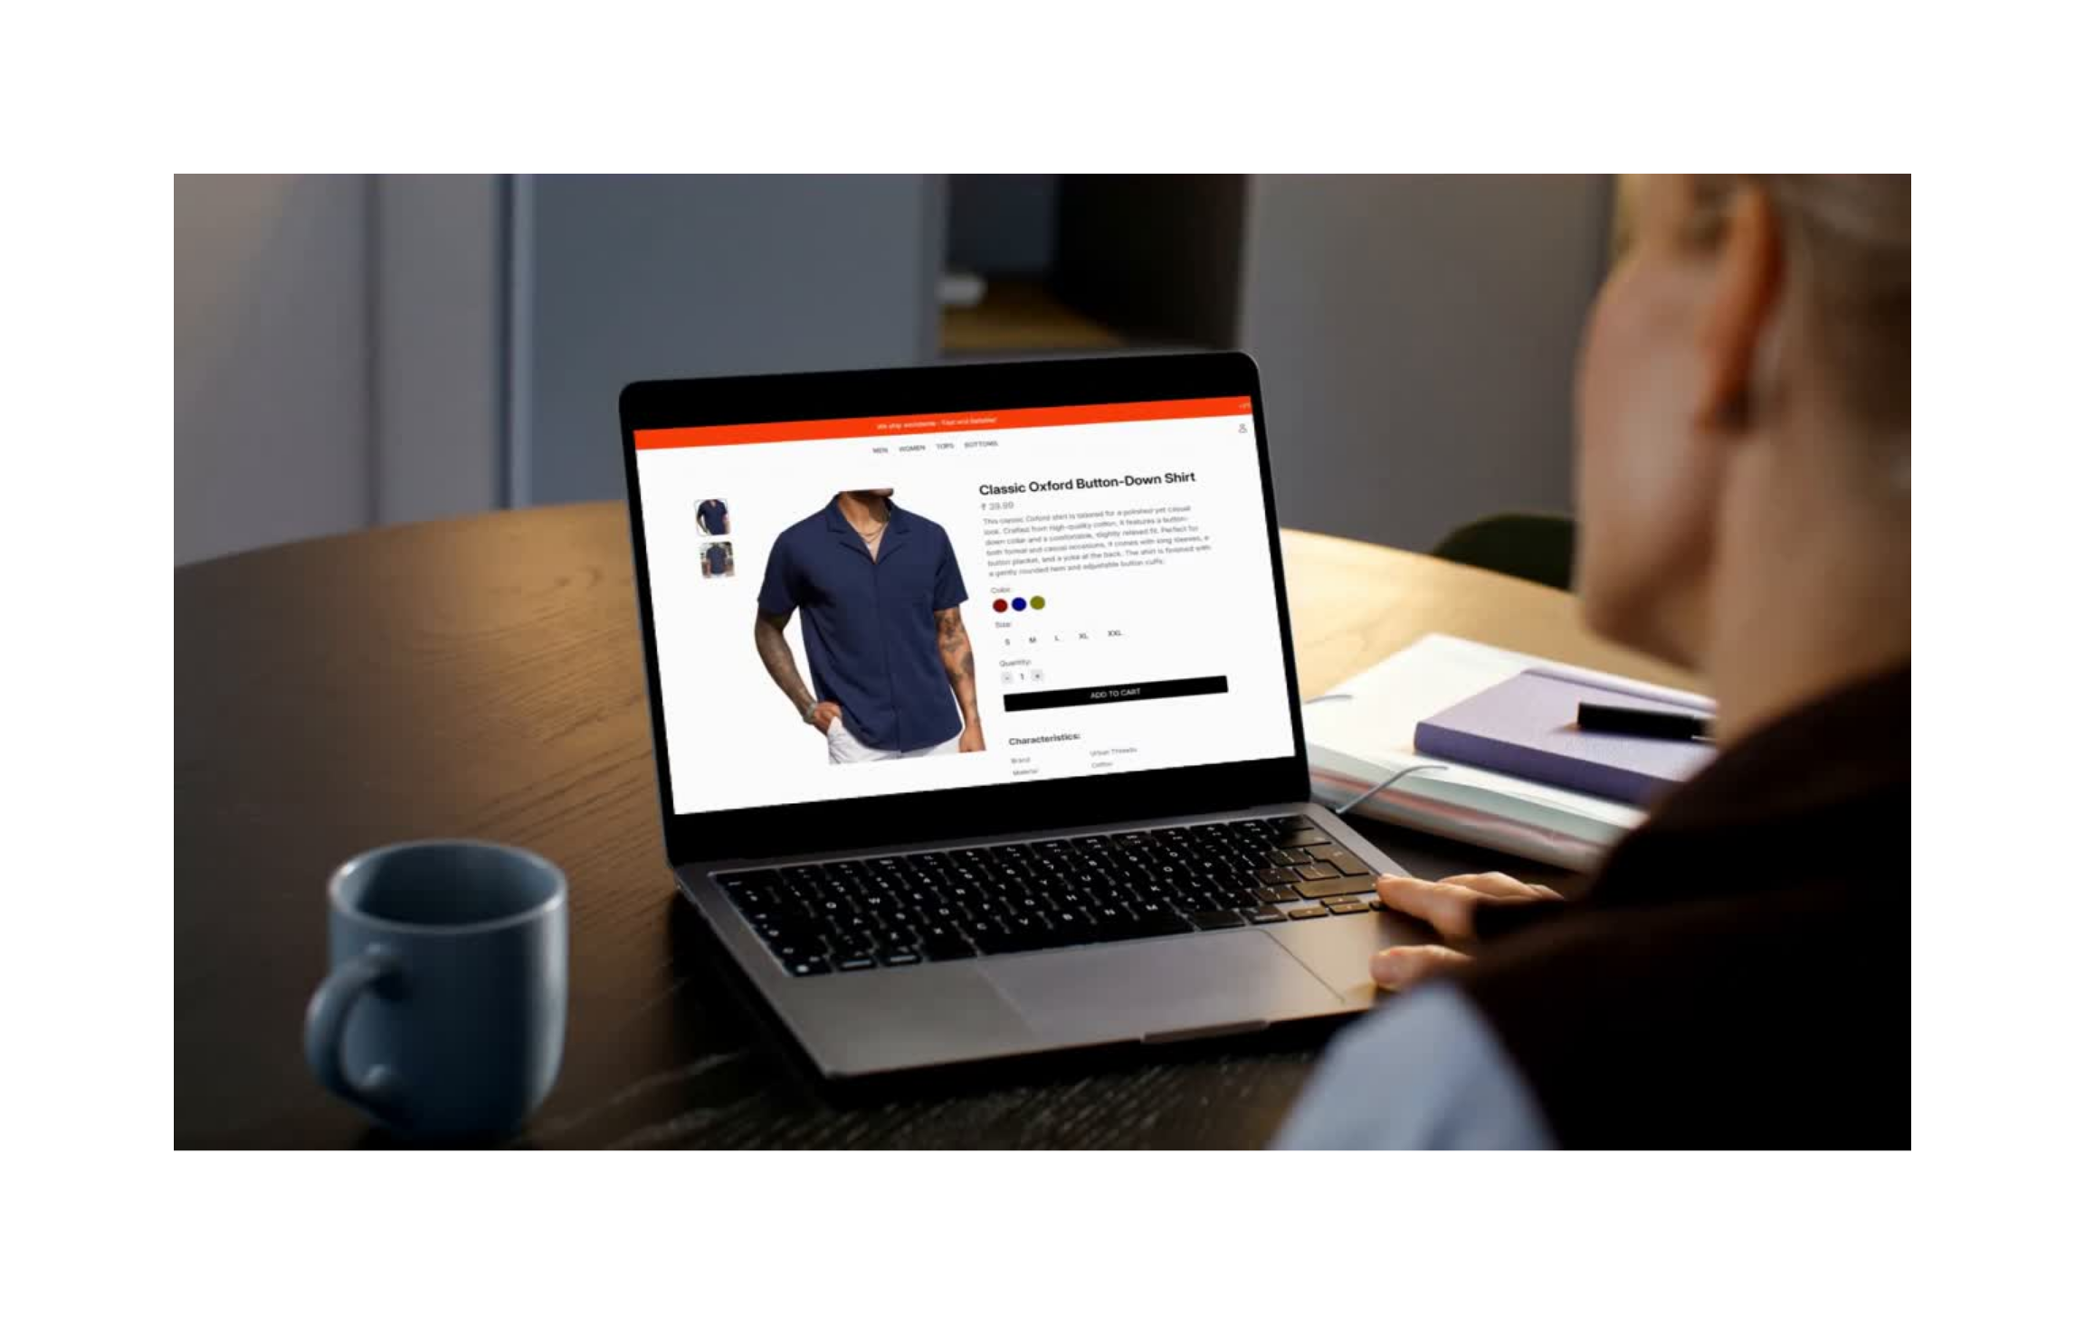

Slide 7
Steps to Buy This Product:
Step 1: Browse product images by clicking the small thumbnails on the left side to view different angles.
Step 2: Review the product name, price (₹39.99), and description to understand its features.
Step 3: Select a color by clicking on one of the colored circles.
Step 4: Choose your size by clicking on one of the available size buttons (S, M, L, XL, XXL).
Step 5: Set the quantity using the plus (+) or minus (–) buttons.
Step 6: Click the “ADD TO CART” button to add the product to your cart.
Step 7: (Optional) Scroll down to view product characteristics like brand and material.

Slide 8
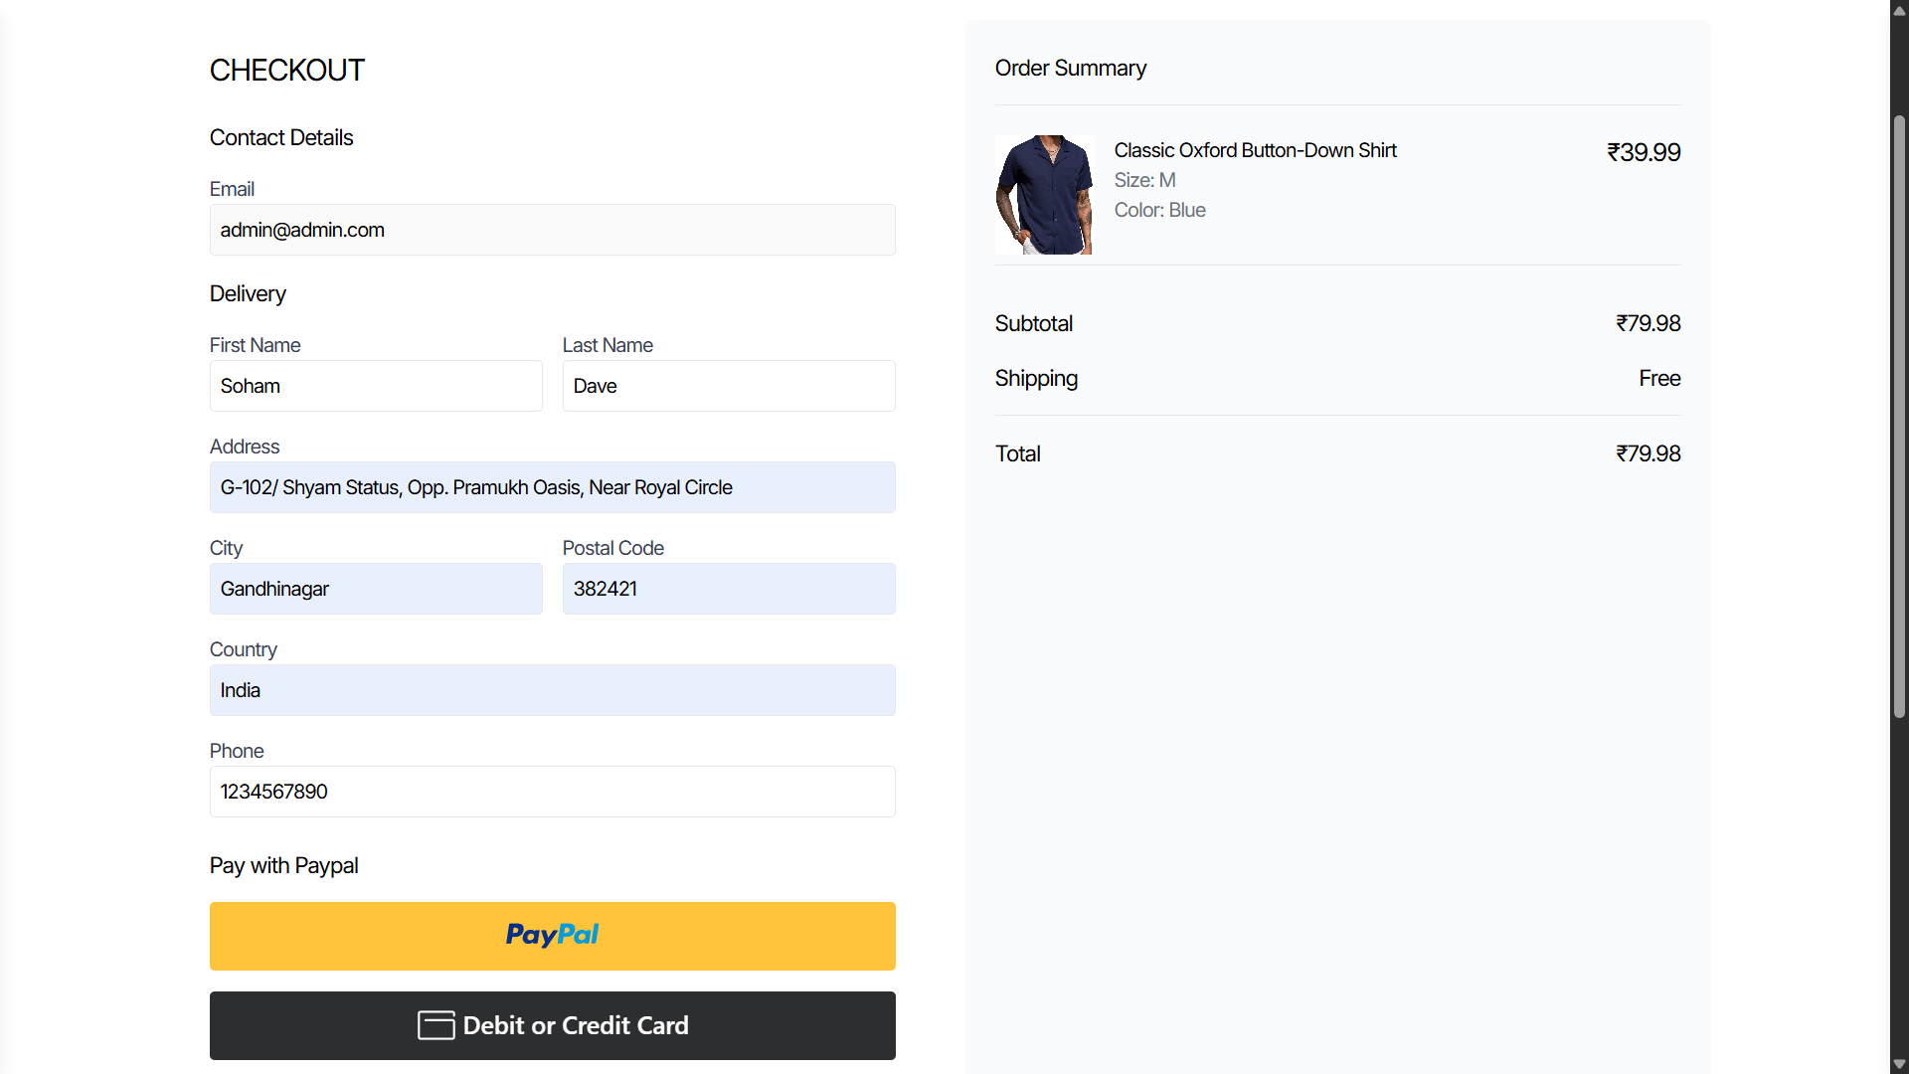

Slide 9
Steps to Place Your Order:
Step 1: Enter your email address under “Contact Details.”
Step 2: Fill in your first name and last name.
Step 3: Enter your full delivery address, including:
Street address
City
Postal code
Country
Phone number
Step 4: Review your Order Summary on the right side, including the item details, quantity, price, and total cost.
Step 5: Choose your preferred payment method:
Click the PayPal button to pay using your PayPal account.
Or click Debit or Credit Card to pay directly with a card.

Slide 10
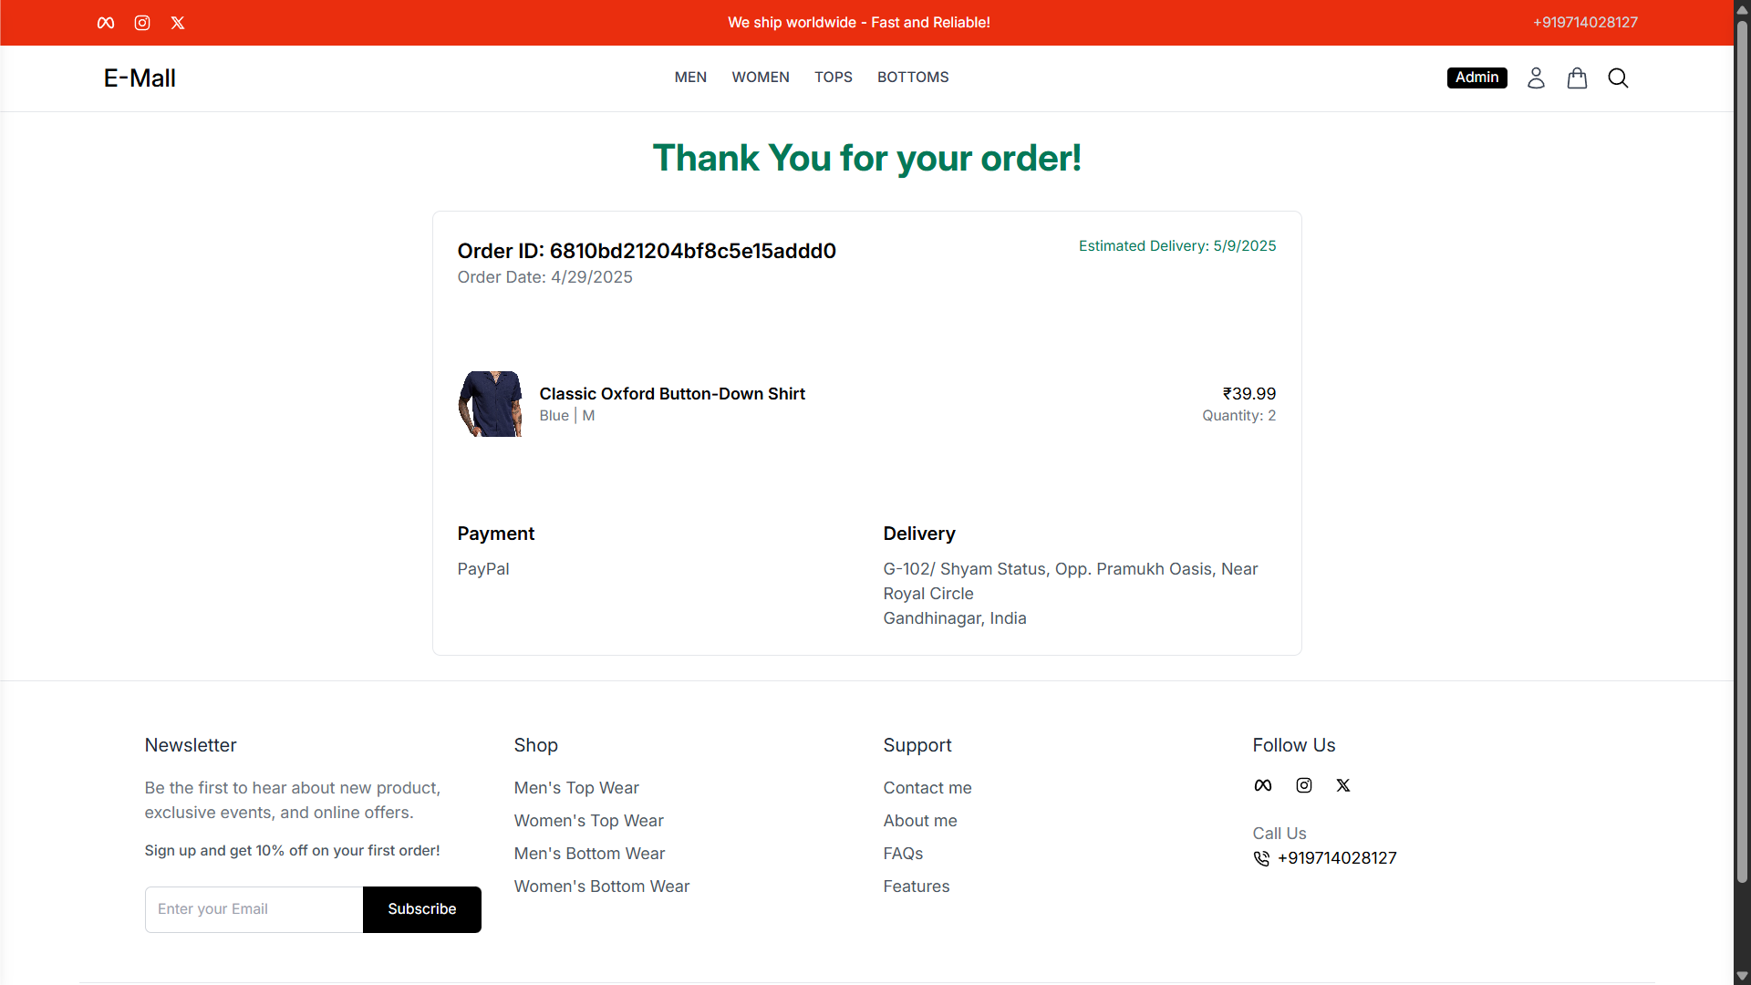

Slide 11
Steps After Placing the Order:
Step 1: Once the order is placed, a confirmation message appears with “Thank You for your order!”
Step 2: Review your Order ID and Order Date displayed at the top.
Step 3: Check the Estimated Delivery Date to know when your item will arrive.
Step 4: View your order details, including:
Product name and image
Selected color and size
Quantity
Price
Step 5: Confirm your Payment Method (e.g., PayPal).
Step 6: Double-check the Delivery Address you provided.

Slide 12
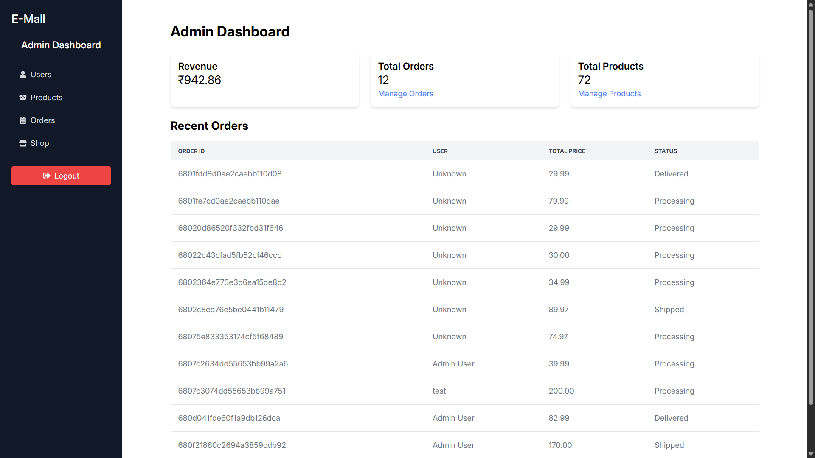

Slide 13
Steps to Monitor and Manage Orders (Admin Panel):
Step 1: Admin logs into the Dashboard from the left sidebar.
Step 2: The top section displays key metrics:
Revenue: Total earnings.
Total Orders: Count of all placed orders.
Total Products: Number of items in the store.
Step 3: Admin can click on Manage Orders or Manage Products for detailed control.
Step 4: In the Recent Orders table, admin can view:
Order ID
User who placed the order
Total Price
Status (e.g., Processing, Shipped, Delivered)
Step 5: Admin can navigate to Users, Products, or Shop from the sidebar for further management.

Slide 14
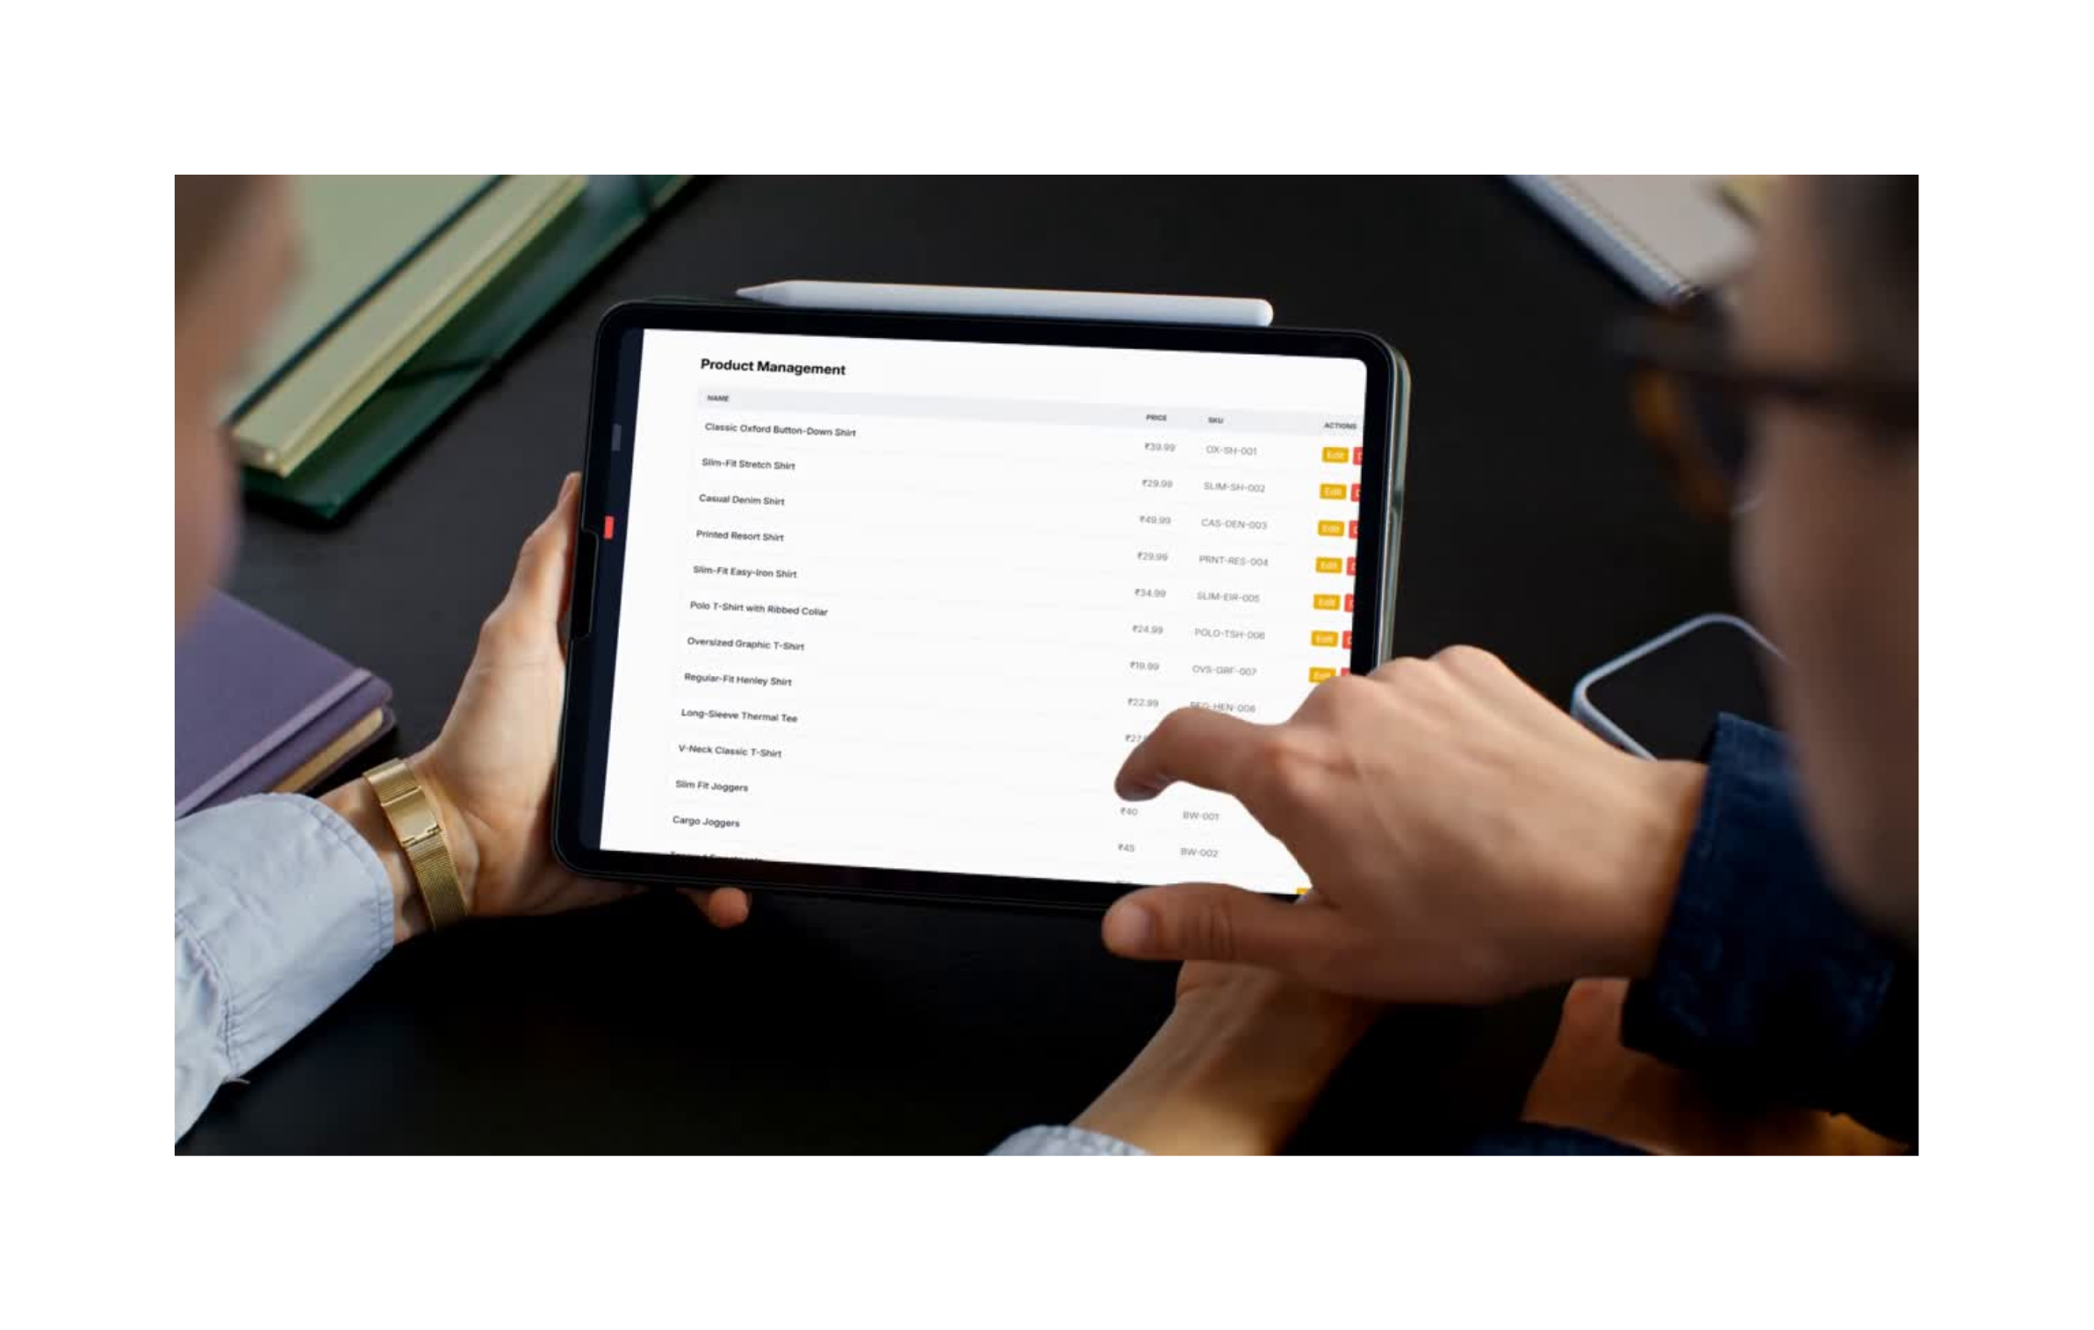

Slide 15
Steps to Manage Products (Admin Panel):
Step 1: Admin clicks on Products from the sidebar to open the Product Management section.
Step 2: The page displays a table of all available products with key information:
Name of the product (e.g., "Classic Oxford Button-Down Shirt")
Price (e.g., ₹39.99)
SKU (Stock Keeping Unit) — a unique product code (e.g., OX-SH-001)
Step 3: For each product, there are two action buttons:
Edit: Allows the admin to update product details like name, price, or SKU.
Delete: Removes the product from the catalog.
Step 4: Admin can scroll through the list to manage more products.

Slide 16

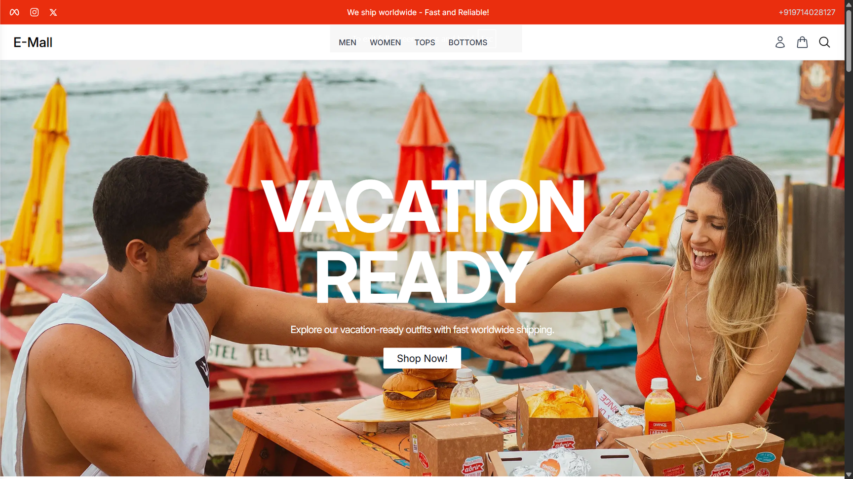
Any questions about E-Mall?
Feel free to ask anything regarding the project and its features.
210170107045
Soham Dave

